Slide 1
Example: Message Board front-end (Part 1)
Creating The Client Project | Header | MeassageAPI Module
Notes:
Welcome to our lecture on example of message board front end part 1. In this lecture we will go through how to create the client project, header, and message api module. Let’s start the video lecture.

Slide 2
Creating The Client Project
Front-end built with React in the MERN stack.
Back-end uses MongoDB, Express, and Node to provide a RESTful API.
Create React App initializes the React project.
Install necessary packages to set up the front-end.
Notes:
Now that we have introduced the topics, let’s begin by setting up the front-end for the project. The front-end is built using a modern framework that connects to the back-end, which handles data processing. The project setup involves initializing the structure and installing the necessary tools to ensure seamless integration with the system.

Slide 3
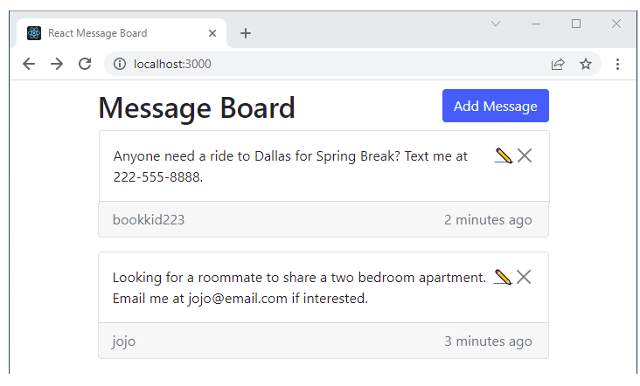
Example
Notes:
Now that we have discussed the setup process, let’s look at an example of how the front-end is initialized. The project is created using a structured approach, ensuring that all required tools are installed. Once the setup is complete, the interface is ready to display content. The front-end connects seamlessly to the system, allowing users to interact with the application.

Slide 4
Header
Header component appears at the top of every screen.
Uses React Bootstrap for layout and styling.
Placed in src/components directory.
Notes:
Now that we have set up the front-end, let’s explore the structure of the interface. The top section of the application includes a dedicated element that remains visible on every screen. It is styled using a layout library to ensure consistency. This element is placed in an organized directory within the project, keeping the structure clean and manageable.

Slide 5
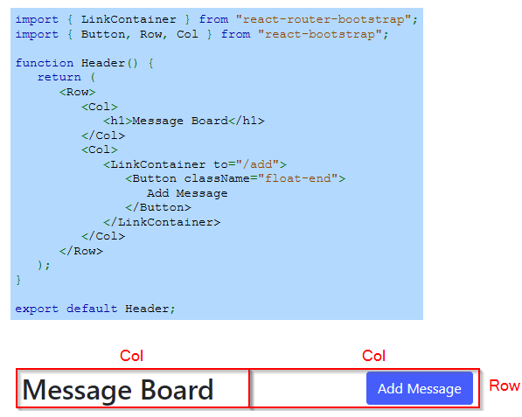
Example
Notes:
Now that we have introduced the structure of the top section, let’s look at how it is implemented. This section is arranged in a flexible layout, ensuring that the title and action button align properly. The layout divides elements into separate areas, keeping the design clean and responsive. This setup provides easy navigation and a consistent user experience across the application.

Slide 6
MessageAPI Module
The following functions use fetch() to send API requests to the web server (mern-server project):
getMessages() - Sends a GET request for all messages.
getMessage() - Sends a GET request for a single message.
addMessage() - Sends a POST request to add a new message.
editMessage() - Sends a PUT request to edit an existing message.
deleteMessage() - Sends a DELETE request to delete a message.
Notes:
Now that we have explored the structure of the interface, let’s look at how it interacts with the system. The application communicates with the back-end through specific requests to retrieve, add, update, and remove data. These requests ensure that all user actions are processed correctly, keeping the system responsive and allowing seamless data management.

Slide 7
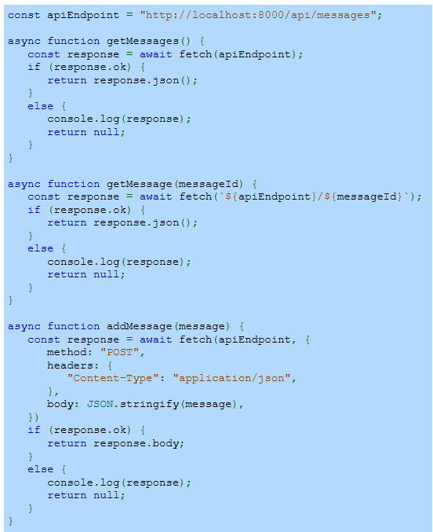
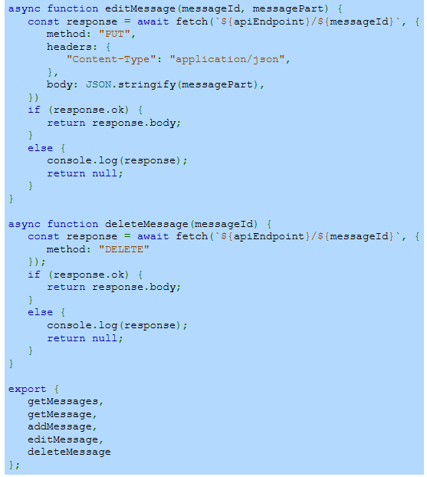
Example
Notes:
Building on our previous discussion, let’s explore how the application connects to the system. Different requests are used to retrieve, add, update, and remove data. Each request ensures smooth interaction between the interface and the back-end. This process allows the system to respond dynamically to user actions, keeping the data accurate and up to date.

